Slide 1
ENV 103
Waste Management

Slide 2
Waste management is the collection, transport, processing, recycling or disposal, and monitoring of waste materials. The term usually relates to materials produced by human activity that cause health hazards or environmental pollution.
Purpose of waste management:
- to reduce the effect of waste on health, the environment or aesthetics.
- to recover resources from waste.
Waste management can involve solid, liquid, gaseous or radioactive substances, with different methods and fields of expertise for each.

Slide 3
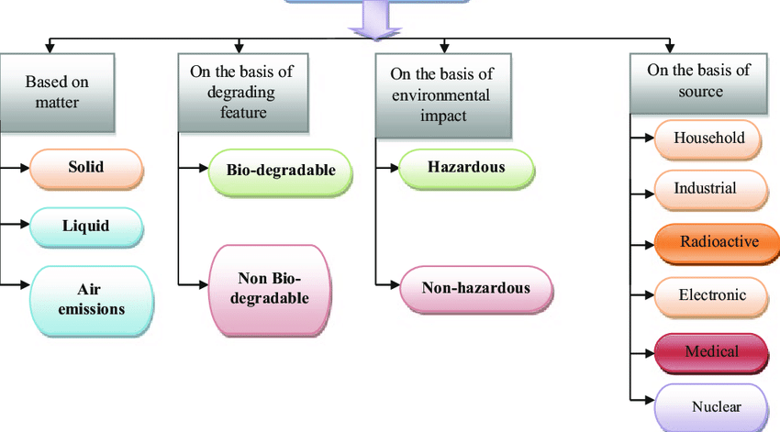
Types of Waste
Solid
Liquid
Recyclable
Hazardous
Organic

Slide 4
Waste management practices are different for developed and developing nation, for urban and rural areas, and for residential and industrial producers. Management for non-hazardous residential and institutional waste in metropolitan areas is usually the responsibility of local government authorities, while management for non-hazardous commercial and industrial waste is usually the responsibility of the generator.

Slide 5
Waste Management concepts
Integrated Waste Management
The dominant concept today in managing waste is known as integrated waste management (IWM).
The 3R’s of IWM are reduce, reuse and recycle
Reduce consumption, reuse material again and again and recycle it.

Slide 6
Waste Hierarchy
The waste hierarchy refers to the "3 Rs" reduce, reuse and recycle, which classify waste management strategies according to their desirability in terms of waste minimization. The aim of the waste hierarchy is to extract the maximum practical benefits from products and to generate the minimum amount of waste.

Slide 7
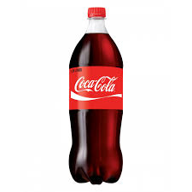
Reuse
Reusing bottles for storing liquids
Rechargeable batteries
Reusing items again and again
Donating old items to the poor

Slide 8

Reduce
Use good quality products
Use durable products
Avoid papers, instead use electronic mediums

Slide 9
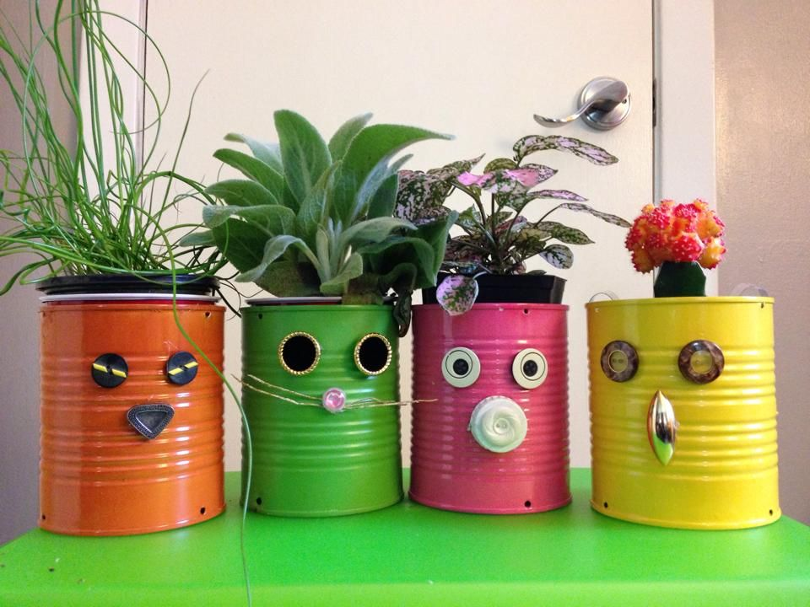
Recycle
Make glass, bottles, showpieces from broken/thrown glass bottles/cups/items
Paper Recycling
Plastic Recycling

Slide 10
Industrial Waste Minimization
Classification:
Hazardous and Non-hazardous
Treatment plants- the processes used for treating wastewater produced by industries. After treatment, the treated wastewater may be reused or released to a sanitary sewer or to a surface water in the environment.
Advantages of waste minimization are:
• minimum use of resources;
• minimum waste production;
• improvement in production process

Slide 11
At least 50% reduction by weight of urban waste is possible by:
Better design of packaging to reduce waste, an element of source reduction (10% reduction)
Establishment of recycling programs (30% reduction)
Large-scale composting programs (10% reduction)

Slide 12
Common methods of managing waste
Composting
Incineration
Landfill
Open dumping

Slide 13
Composting
-is a biochemical process in which organic materials such as kitchen scraps decompose to a rich, soil like material. Composts can be used as fertilizers as a source of nutrients.
Benefits of composting:
Enriches soil
Reduces need of chemical fertilizers

Slide 14
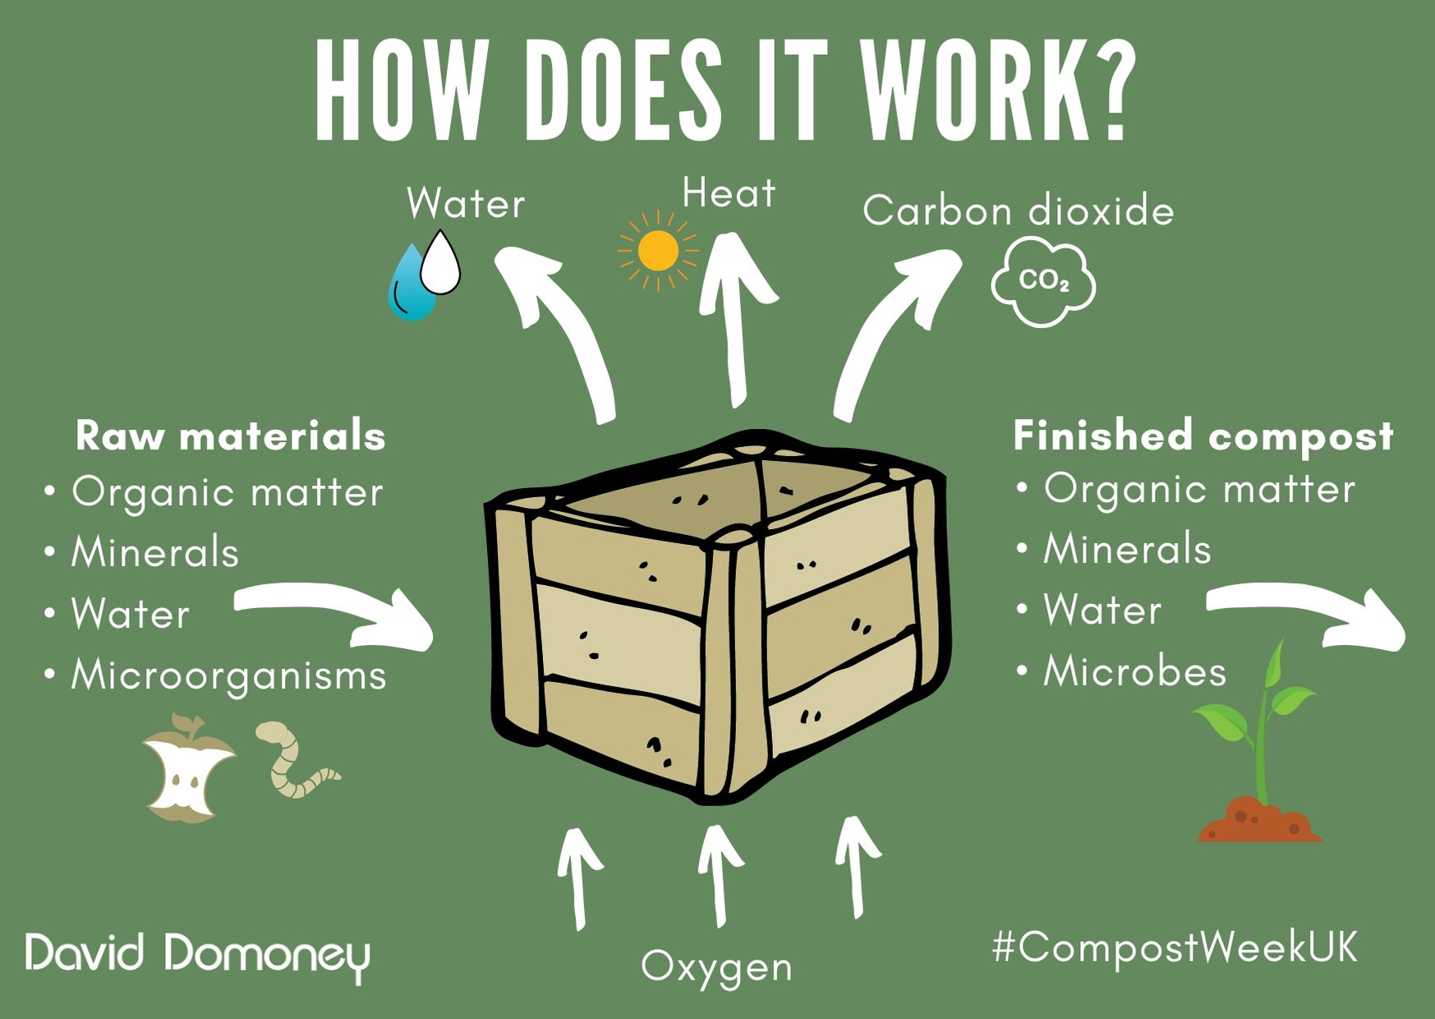

Slide 15
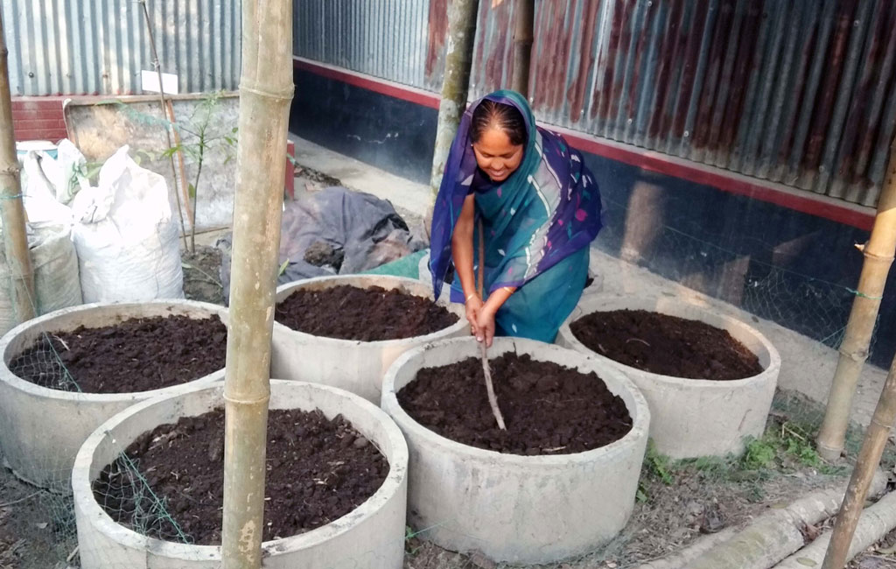
Fig. Woman from a rural area preparing compost

Slide 16
Incineration
Combustible waste is burned at temperature high enough (900-1000⁰C) or (1650-1830⁰F) to consume all combustible material, leaving only ash and non-combustible to dispose of in a landfill.
This process reduces the volume of solid wastes to 20-30% of original volume.

Slide 17
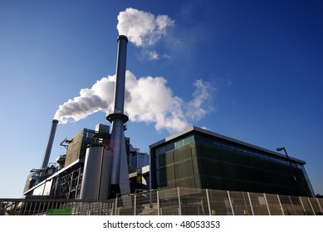
Fig. Incineration plant

Slide 18
Open dumping
In many places of our country, solid waste is accumulated in open dumps where refuse was piled up without being covered or otherwise protected.
Open dumps creates health hazard, polluting air and sometimes polluting groundwater and surface water.

Slide 19
Landfill
Disposing of waste involves burying the waste and remains and is a common practice in most countries.
Properly designed and well managed landfill can be a hygienic and relatively inexpensive method of disposing of waste materials.
May cause leaching leading to ground water contamination.
May cause air pollution.
Plastics take 1000 years to decompose and releases harmful toxins in the soil.

Slide 20
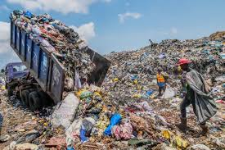

Slide 21
Waste generation in Dhaka City
Dhaka City Corporation (DCC) responsible for waste collection
Following landfill method to manage waste
Dhaka City Consists of 2 city corporations
Dhaka North City Corporation (DNCC)
Dhaka South City Corporation (DSCC)
Waste Generation of DNCC : 4220 tons/day (approx.)
Aminbazar landfill site: manage 2774 tons/day
Waste Generation of DSCC : 3319 tons/day (approx.)
Matuail landfill site: manage 2605 tons/day
Per capita waste generation: 0.56 kg/day/per person (approx.)

Slide 22
Locations of landfill site (DNCC and DSCC)

Slide 23
Composition of waste at Dhaka City

Slide 24
Current Situation in Dhaka City
NGOs, community and working on door to door collection, motivation and cleaning of roads & drains.
DCC collects wastes from secondary transfer points
DCC also responsible to change waste containers on specific locations
DCC encourages all the CBOs and NGOs to go for Solid Waste recycling and composting with own initiatives.
DCC has floated tender for Solid Waste Management through Private Sector Participation in two zones in the city.
Prepared first master plan with the cooperation of JICA in 2005 known as ‘Green Dhaka Clean Dhaka Plan’’

Slide 25
CHALLENGES
• Large number of population and a large quantity of waste generation
Lack of Public Awareness
• Inefficient Primary Collection System
• Shortage of Secondary Transfer Station
• No formal Segregation of Waste
• No Intermediate Treatment facilities
• Shortage of manpower Landfill Management

Slide 26
Future Plans
Approval and execution of second waste management master plan for Dhaka City
Increase of public awareness
Proper segregation of waste
Setting up hubs for secondary waste collection throughout the city
The induction of incineration plant at Aminbazar Landfill.
Eco-Town for Nasirabad Landfill

Slide 27
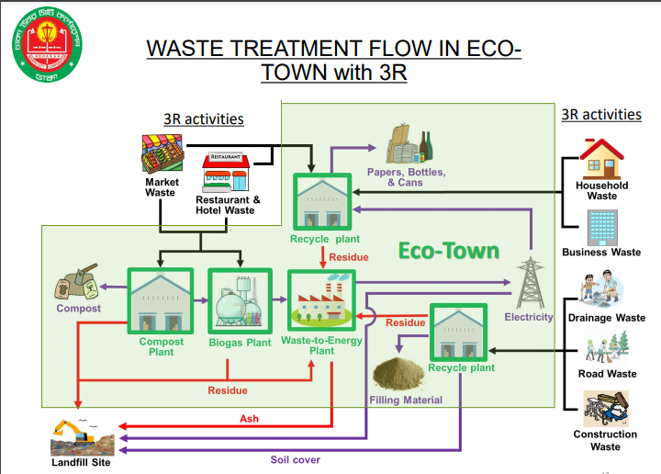

Slide 28
THANK YOU

